Slide 1


NYC JOB APPLICATION RECOMMENDATION
by
-MEHMET OZKEMAH-
THINKFUL DATA SCIENCE FLEX PROGRAM
FINAL CAPSTONE PROJECT

Slide 2
TABLE OF CONTENT
PROJECT OVERVIEW
Slide 3
DATA FACTS
Slide 4-5
EXPLORATORY DATA ANALYSIS
Slide 6-16
UNSUPERVISED LEARNING
Slide 17-26
NATURAL LANGUAGE PROCESSING
Slide 27-37
SUPERVISED LEARNING
Slide 38-43
RECOMMENDATIONS
Slide 44
ROOM TO IMPROVE
Slide 45
QUESTIONS & ANSWERS
Slide 46

Slide 3

PROJECT OVERVIEW
THE PURPOSE OF PROJECT;
TO HELP NYC GOVERNMENT JOB APPLICANTS TO UNDERSTAND THE DEMAND FOR CERTAIN PROFESSIONS, JOB TITLES, SALARY RANGES OR INDUSTRIES AND DEFINE SKILLS THAT ARE MOST FREQUENTLY REQUIRED BY EMPLOYERS, MAKE RECOMMENDATION

Slide 4
DATA IN A NUTSHELL
NYC JOB APPLICATION RECOMMENDATION
This dataset contains current job postings available on the City of New York’s official jobs site. Internal postings available to city employees and external postings available to the general public are included.
Data Source
Data Shape
Variable Types
Characteristics
https://data.cityofnewyork.us/City-Government/NYC-Jobs/kpav-sd4t/data
Float : 1
Int : 2
Object : 25
Multivariate
Sequential
Time-Series
28 Columns
3420 Rows

Slide 5
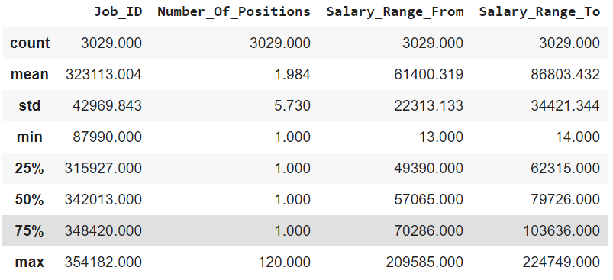
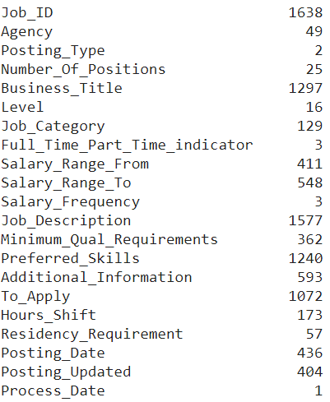
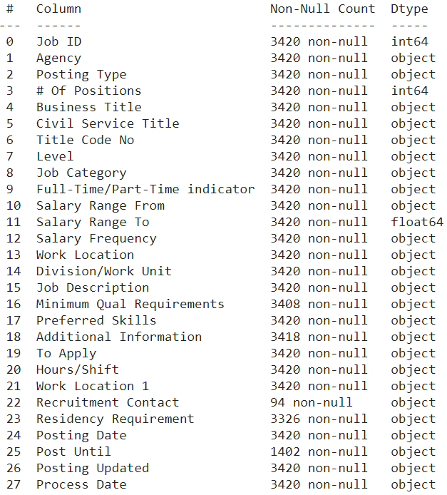
UNDERSTANDING THE DATA
Descriptive Statistics
Describe
Unique Values
Count

Slide 6

EXPLORATORY DATA ANALYSIS
MODELING Compare the models &
Select the right model.
4
DATA CLEANING Detect the problems with the data and eliminate them.
1
3
FEATURE ENGINEERING Select, modify or create useful features.
DATA EXPLORATION Explore and understand the data.
2

Slide 7

Exploratory Data Analysis
1
1
Data Cleaning

Slide 8
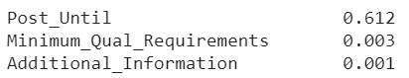
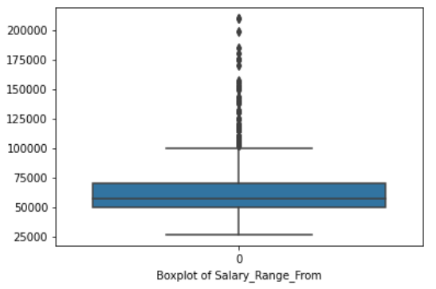
EXPLORATORY DATA ANALYSIS
Data Cleaning
Missing Value %
Handling with messy column names
Dropping unneeded columns
Data type change
Detecting and handling missing values
Removed duplicated entries
Converting data to right type
Salary_Range_From have no outlier

Slide 9

Exploratory Data Analysis
2
Data Exploration

Slide 10
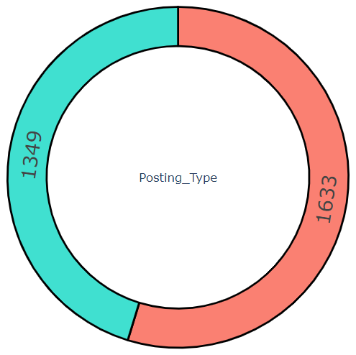
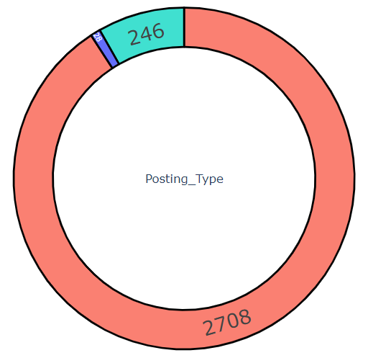
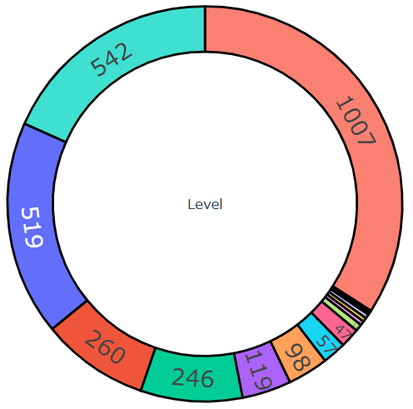
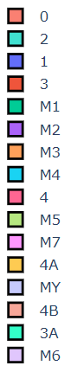
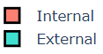
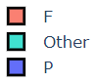
EXPLORATORY DATA ANALYSIS
Data Exploration
Level 0 has the greatest number of vacancy
Well-balanced Posting Types
Most jobs are Full-Time

Slide 11
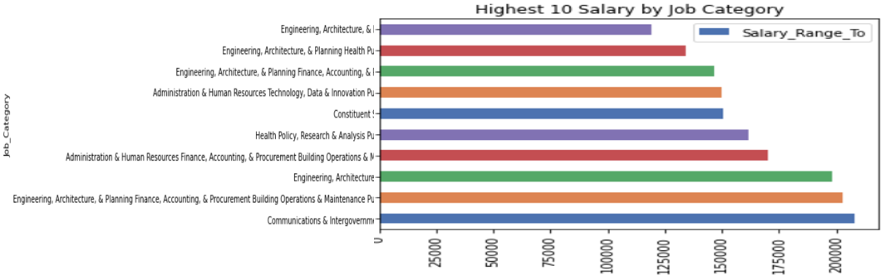
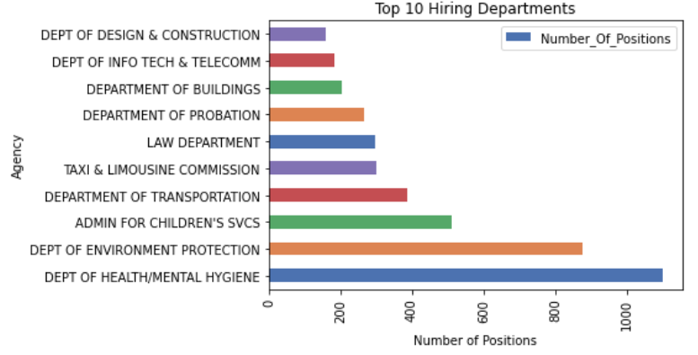
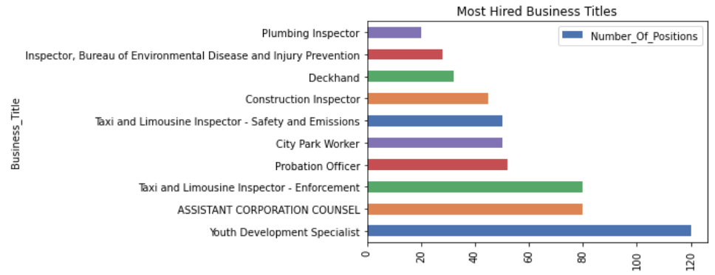
EXPLORATORY DATA ANALYSIS
Data Exploration
Most paid category is Engineering
Top 10 Hiring Departments
Top 10 Vacany by Business Title

Slide 12
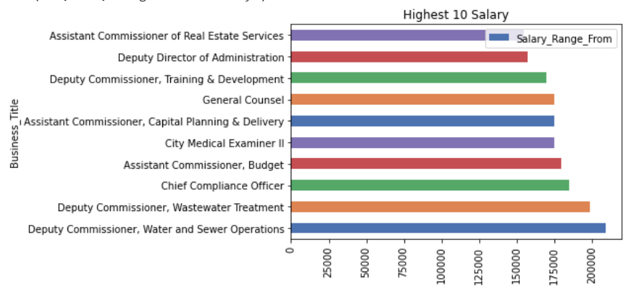
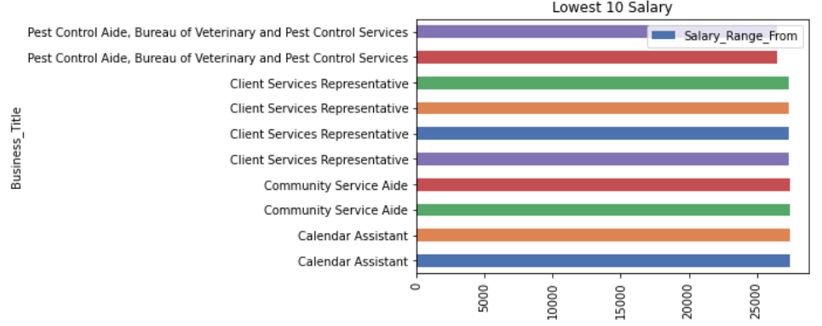
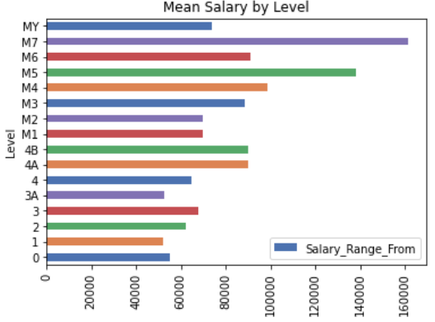
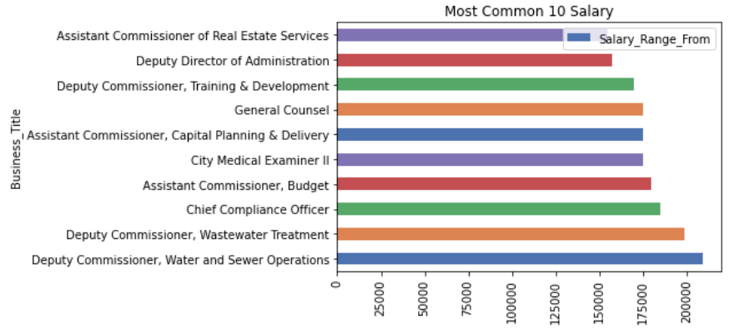
EXPLORATORY DATA ANALYSIS
Data Exploration / Salary Facts
Highest 10 Salaries by Business Title
Lowest 10 Salaries by Business Title
Mean Salary by Level
Most Common 10 Salary by Business Title

Slide 13
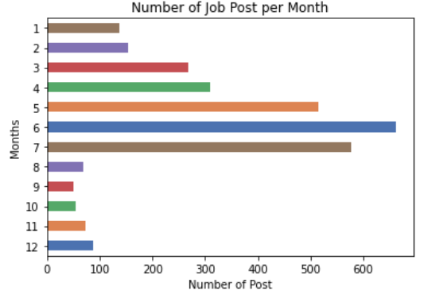
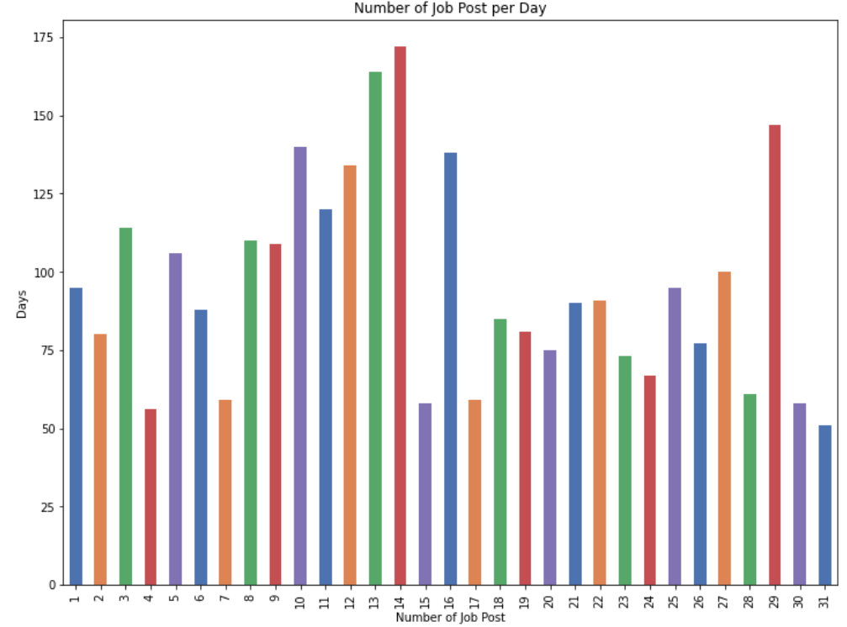
EXPLORATORY DATA ANALYSIS
Data Exploration / Posting Timing
High season for hiring seems to be
May-June-July.
March and April are better than the rest of the
year excluding high season.
Most jobs are posted the second week of the
month

Slide 14

Exploratory Data Analysis
3
Feature Engineering

Slide 15
EXPLORATORY DATA ANALYSIS
Feature Engineering
Number of columns changes based on the model working with
Initial Features
Supervised Learning
Unsupervised Learning
NLP
28
Column
13
Column
31
Column
2
Column
New features created (Salary Range Difference & Salary Range Mean & Salary Class)
Dummy columns created
Year column splitted into different columns
Unnecessarily columns and rows removed

Slide 16

Exploratory Data Analysis
4
Modeling
1
3
2

Slide 17
UNSUPERVISED LEARNING

Slide 18
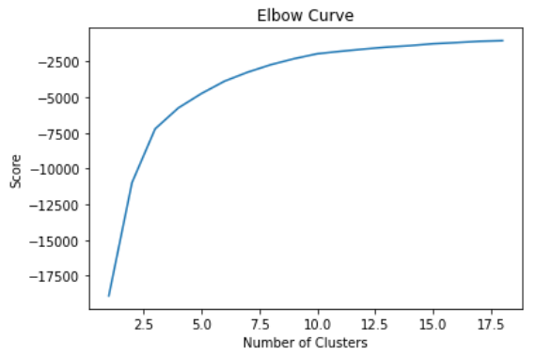
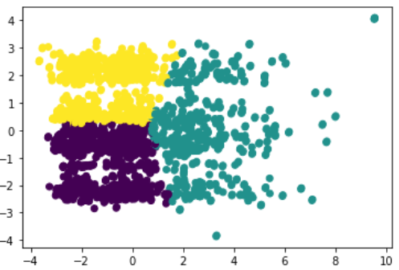
UNSUPERVISED LEARNING
K-Means
3 clusters observed in plot
K-Means Clustering | Silhouette Scores
3 Cluster | 0.39
4 Cluster | 0.37
5 Cluster | 0.37
Elbow curve reveals 3 cluster
3 clusters observed in plot
1
3
2

Slide 19
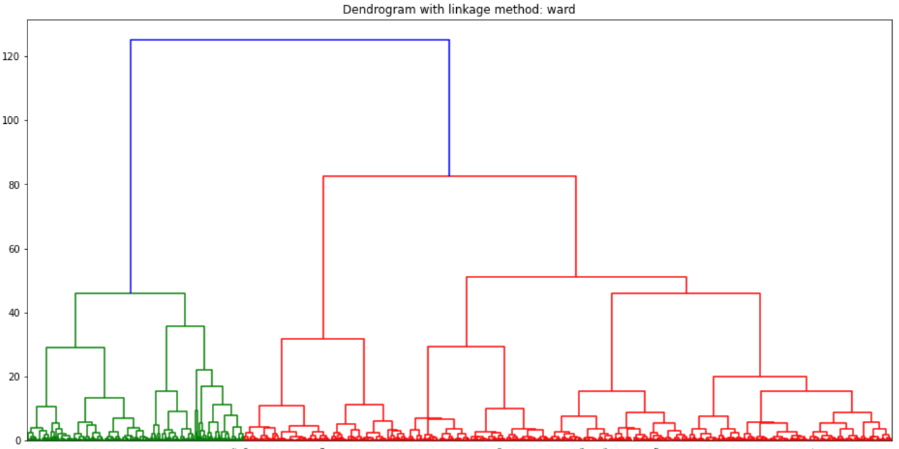
UNSUPERVISED LEARNING
Hierarchical Clustering
Average method is producing the best score
Best dendrogram is produced by Ward method
Hierarchical Clustering | Silhouette Scores
Ward | 0.38
Average | 0.40
Complete | 0.28

Slide 20
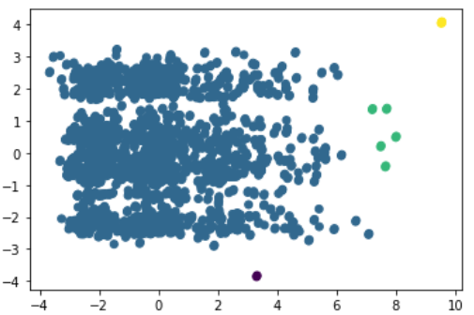
UNSUPERVISED LEARNING
DBSCAN Approach
Silhouette score of DBSCAN solution is 0.36
Model is not revealing right number of cluster

Slide 21
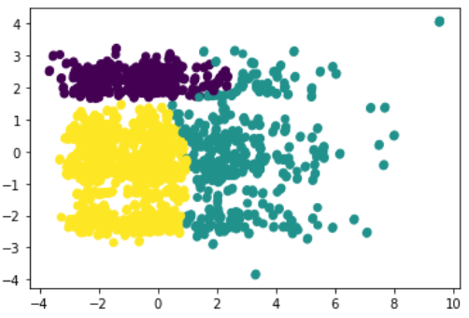
UNSUPERVISED LEARNING
Gaussian Mixture Model
All the methods perform at the same low level
Scatter Plot reveals 3 groups, similar to K-means
Gaussian Mixture Covariance Type | Silhouette Scores
Full | 0.39
Tied | 0.37
Diagonal | 0.39
Spherical | 0.39
1
2
3

Slide 22
UNSUPERVISED LEARNING
Comparing the Models
None of the models perform well.
All the models reveal very close scores.
We can ignore DBSCAN model score as it’s # of cluster is not correct.
Models | Silhouette Scores | # of Cluster
K-Means | 0.39 | 3
Hierarchical Clustering | 0.38 | 3
DBSCAN Approach | 0.36 | 2
Gaussian Mixture Model | 0.39 | 3

Slide 23
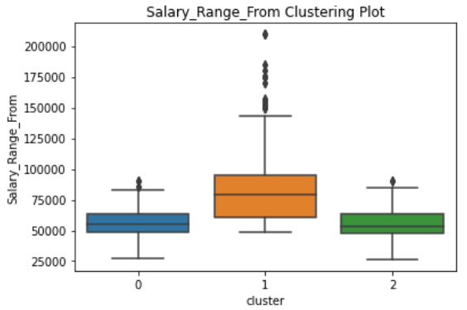
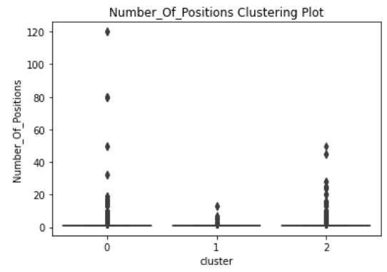
UNSUPERVISED LEARNING
Clusters
Clusters | #Of Posting | Mean Salary | # of Positions
Cluster 0 | 887 | 64,702 | 2,635
Cluster 1 | 722 | 108,070 | 1,168
Cluster 2 | 1222 | 71,583 | 1,901
Number of job post is well-balanced
Cluster 1 has the highest mean salary
Cluster 0 has the highest number of positions
Negative correlation between #of position and mean salary

Slide 24
UNSUPERVISED LEARNING
Clusters
Cluster
1
Cluster
0
# of Positions
Mean Salary
Cluster
2
Cluster
2
Cluster
0
Cluster
1

Slide 25
UNSUPERVISED LEARNING
RESULT
Based on given dataset, I prefer to move with K-means Clustering as it has the highest silhouette score and correct cluster prediction
K-means is also easy to implement which saves time.

Slide 26
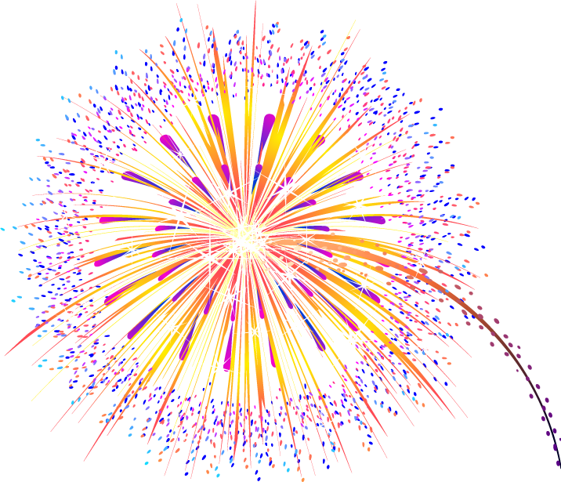
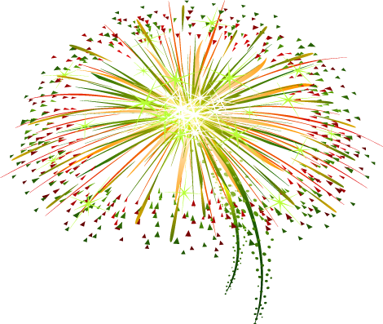

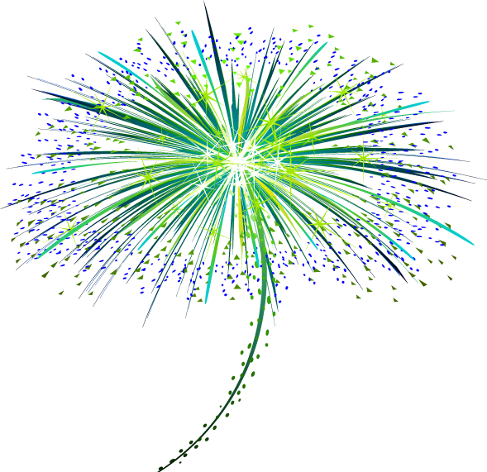





Winner is K-MEANS MODEL

Slide 27
NATURAL LANGUAGE PROCESSING

Slide 28
NATURAL LANGUAGE PROCESSING
Process Summary
Data cleaning, creating text column
Feature engineering: New dataset created with related features
Different data exploration techniques used:
WordCloud
Unigram, Bigram, Trigram Analysis
Modeling: Different models used (LRM, Random forest, Gradient Boosting)
Different feature generation methods used:
BoW
N-grams
TF-IDF
Word2vec
CountVectorizer

Slide 29


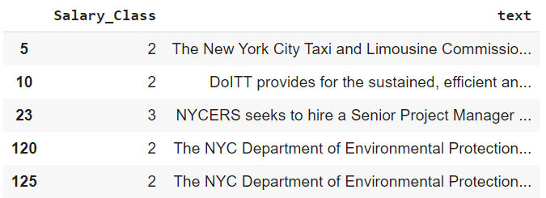

NATURAL LANGUAGE PROCESSING
Final Dataset for NLP
Job Description
Requirements
Preferred Skills

Slide 30
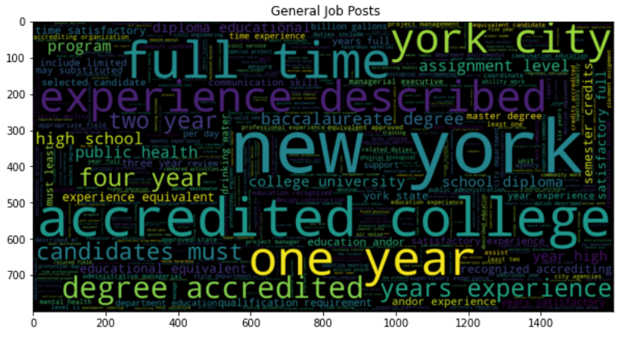
NATURAL LANGUAGE PROCESSING
Which words are most common used in job posts

Slide 31
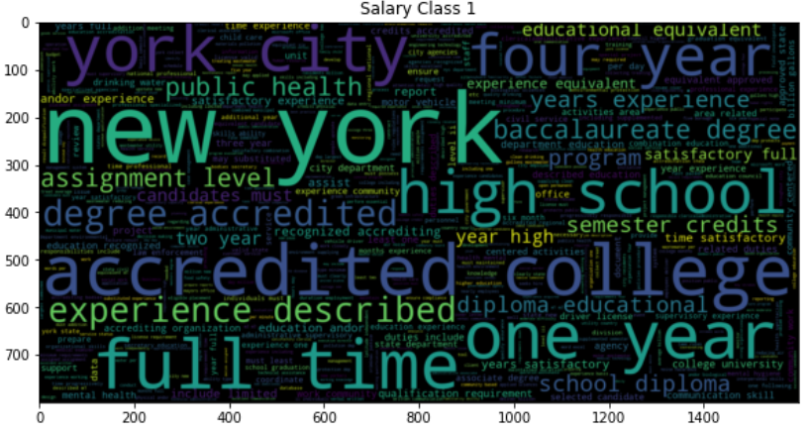
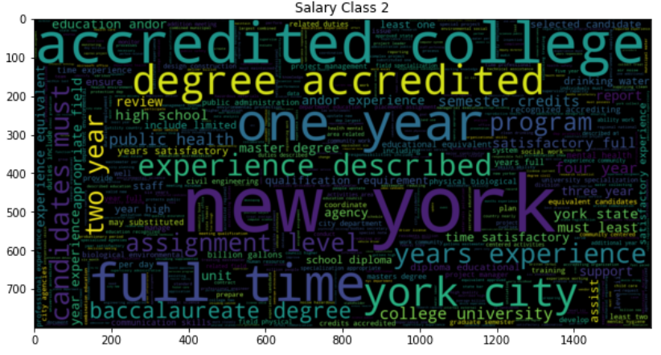
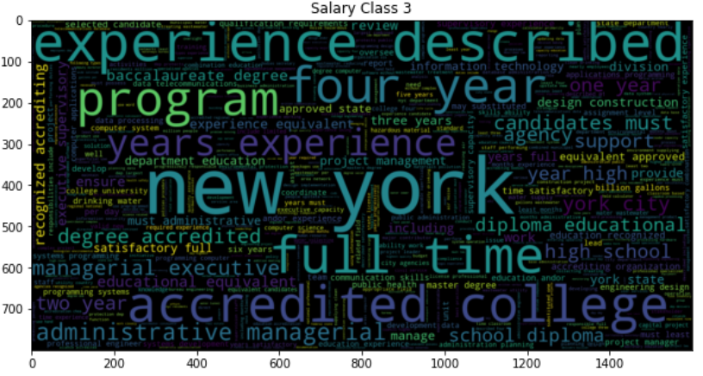
NATURAL LANGUAGE PROCESSING
Which words are mostly used based on Salary Classes
New York, full time, accredited college are most common words in each group
Years experienced and experienced described more repeated in class 3
High school is more visible in class 1
Administrative managerial and managerial executive are seen only in class 3

Slide 32
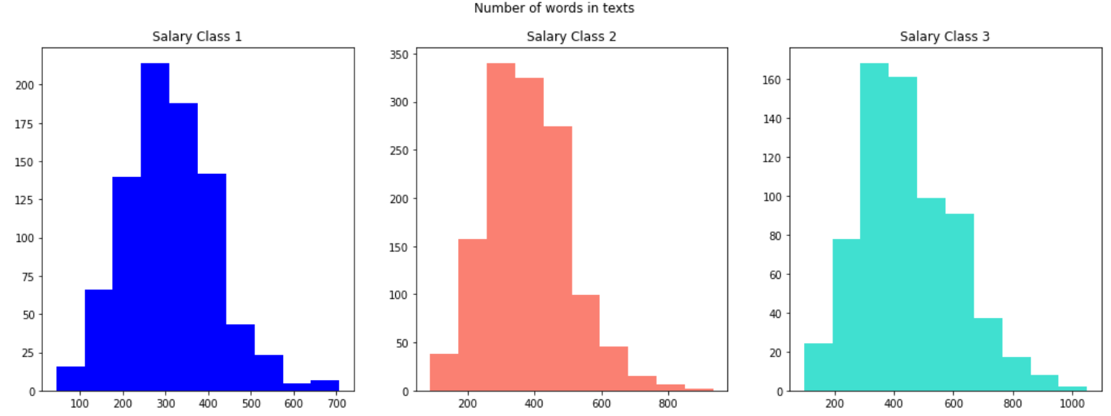
NATURAL LANGUAGE PROCESSING
Number Of Words in Texts
They all distribute normally.
Most common number of words for Class 1 is less than 300, while it is more than 300 for Class 2 and Class 3

Slide 33
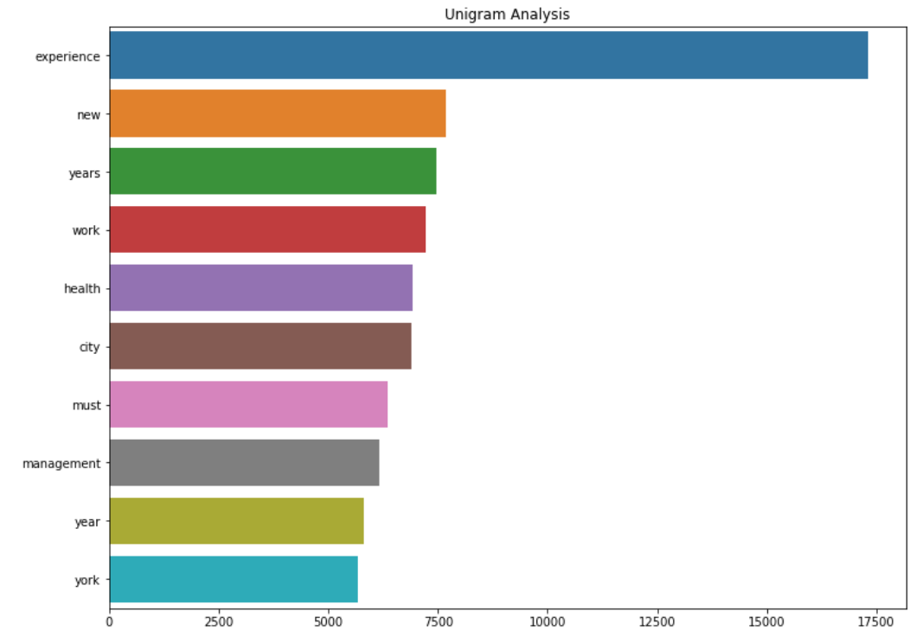
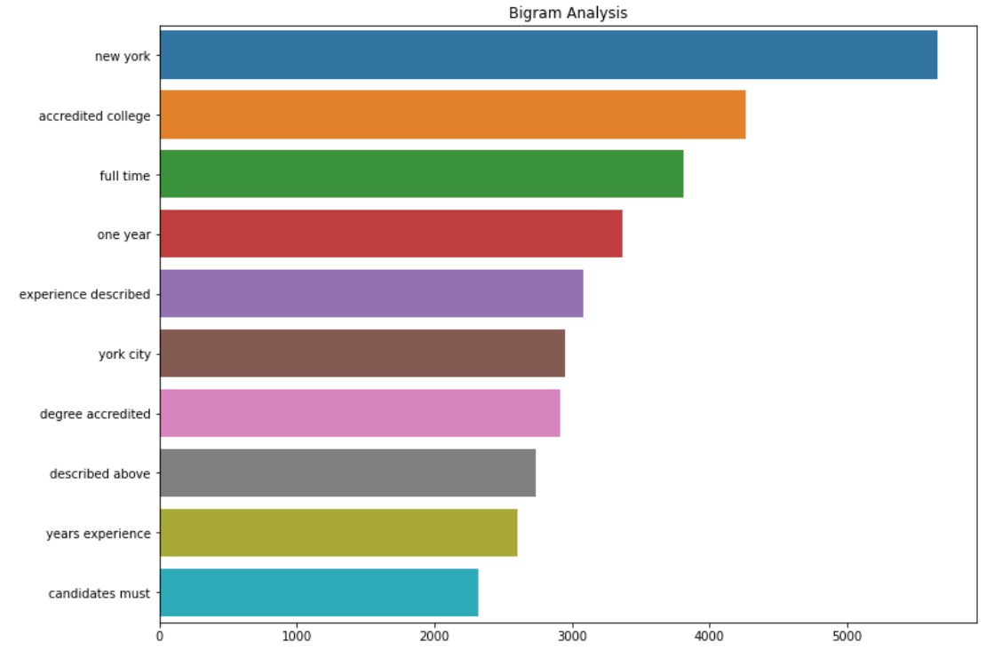
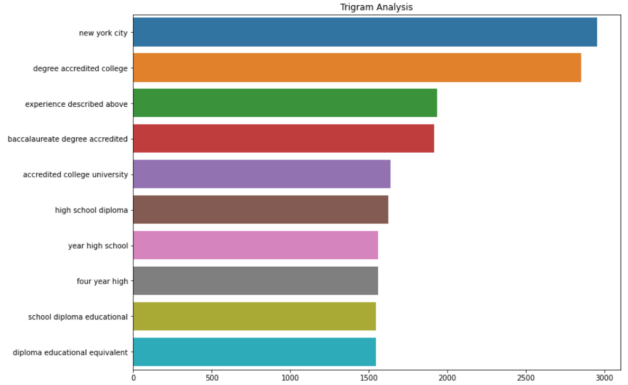
NATURAL LANGUAGE PROCESSING
N-Gram Analysis
Experience is the most common word.
Followed by new and years
New York is the most common word.
Followed by accredited college and full time
New York City is the most common word.
Followed by degree accredited college and experience described above

Slide 34

NATURAL LANGUAGE PROCESSING
NLP Model Comparison
Models | R^2 | Precision Score | Recall Score | F1 Score | Cross Validation Score Mean | Cross Validation Score Std | GridSearch CV
Logistic Regression | 0.54 | 0.40 | 0.45 | 0.31 | 0.48 | 0.01 | 0.99
Random Forest | 0.71 | 0.92 | 0.92 | 0.92 | 0.64 | 0.03 | 0.69
Gradient Boosting | 0.75 | 0.92 | 0.91 | 0.91 | 0.62 | 0.03 | 0.91

Slide 35
NATURAL LANGUAGE PROCESSING
NLP Model Comparison / under different methods
Models | BoW | N-gram (1,2) | N-gram (2,2) | Tf-Idf | Tf-Idf with N-gram (2,2) | W2vec
Logistic Regression | 0.88 | 0.99 | 0.99 | 0.92 | 0.93 | 0.48
Random Forest | 0.89 | 0.99 | 0.99 | 0.99 | 0.99 | 0.99
Gradient Boosting | 0.77 | 0.97 | 0.94 | 0.98 | 0.96 | 0.98

Slide 36
NATURAL LANGUAGE PROCESSING
RESULT
Based on given dataset, I prefer to move with Random Forest Model as it produces the highest score under different methods. It also has very high precision and recall score and easier to tune than Gradient Boosting.

Slide 37
Winner is RANDOM FOREST MODEL

Slide 38
SUPERVISED LEARNING

Slide 39
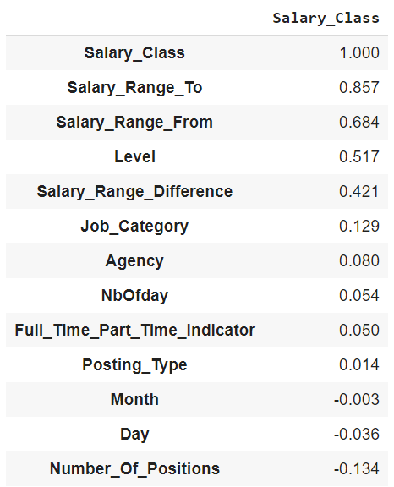
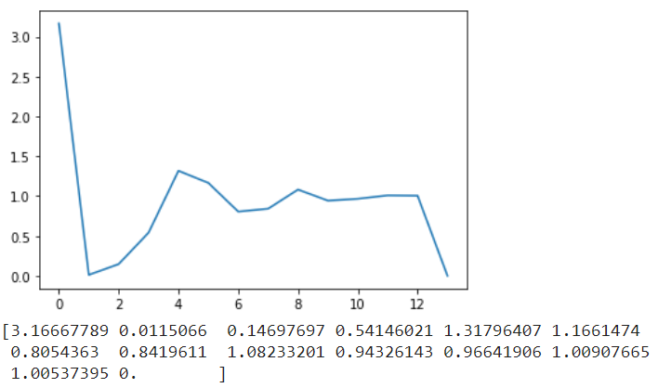
SUPERVISED LEARNING
Feature Engineering
Correlation
Eig_val_cov
Both the scree plot and the eigenvalues >1rule agree that we should keep only 6
components.

Slide 40
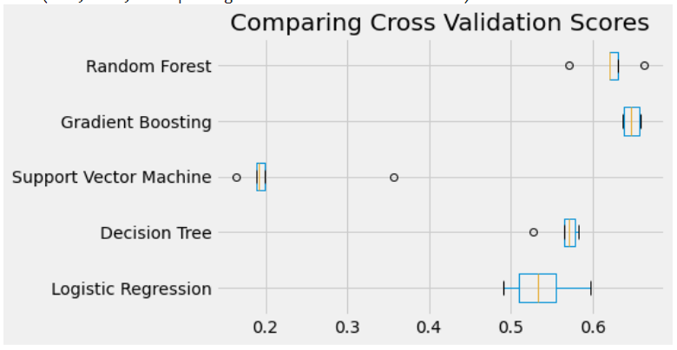
SUPERVISED LEARNING
Supervised Learning Model Comparison

Slide 41
SUPERVISED LEARNING
Supervised Learning Model Comparison
Models | R^2 | Cross Validation Score Mean | Cross Validation Score Std | Precision Score | Recall Score | F1 Score
Logistic Regression | 0.54 | 0.53 | 0.03 | 0.34 | 0.34 | 0.31
Decision Tree Regression | 0.55 | 0.56 | 0.02 | 0.29 | 0.32 | 0.27
Support Vector Machine | 0.30 | 0.22 | 0.07 | Not Supported | Not Supported | Not Supported
Gradient Boosting | 0.72 | 0.64 | 0.01 | 0.34 | 0.34 | 0.34
Random Forest | 0.76 | 0.62 | 0.02 | 0.32 | 0.32 | 0.32

Slide 42
SUPERVISED LEARNING
RESULT
Based on selected scores, Random Forest and Gradient Boosting models are the best performing models. I prefer to move with Random Forest model as it's R^2 is slightly higher than Gradient Boosting.
Although it is less interpretable, the predictive performance of Random Forest model is always on top and it also provides a reliable feature importance estimate.

Slide 43
Winner is RANDOM FOREST MODEL

Slide 44
RECOMMENDATIONS FOR APPLICANTS
Do not think that NYC will hire internally. Posting type variable is very well-balanced. There are opportunities for both internal and external.
Most jobs are full time.
Highest paid category is Engineering.
Consider which positions are more needed by which department.
Consider keywords before applying.
Consider timing to apply.
WISH YOU LUCK!

Slide 45
ROOM TO IMPROVE
This project would have provided better solutions if I had;
Well-balanced year data
More numeric data
Better data entrance
Any information about applicant profile (age, sex, etc.)
If NY City officials can manage the data entrance process in a more productive way, this project produce better solution with the same codes.

Slide 46
THANK YOU!
ANY QUESTIONS?

